Slide 1

Web scraping to gain company insights
Likitha G

Slide 2
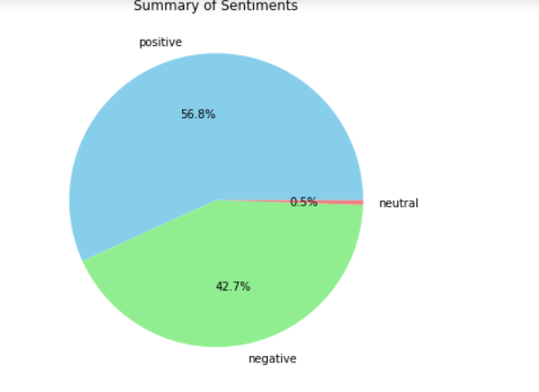
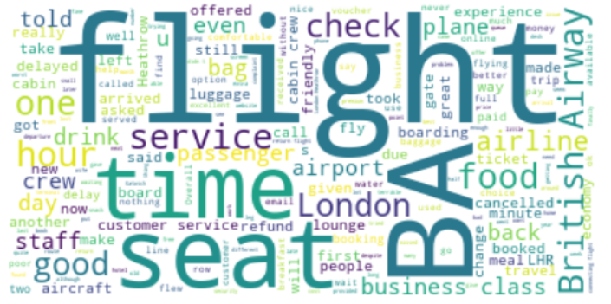
INSIGHTS FROM CUSTOMER REVIEWS
From cleaning 1000 reviews given by the customers, we obtained
Positive Reviews - 568
Negative Reviews - 427
Neutral Reviews – 5
Word cloud of keywords used in reviews

Slide 3
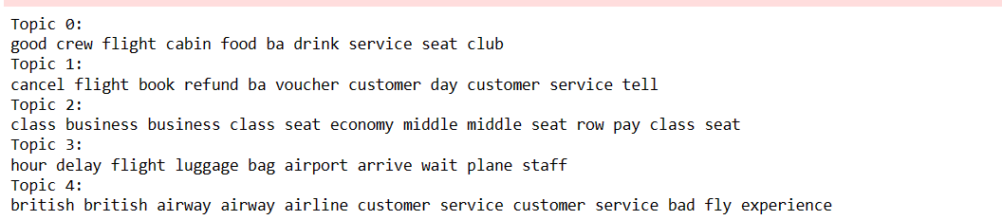
INSIGHTS FROM CUSTOMER REVIEWS
Topics widely discussed using LDA :
It appears that the NMF model has generated more interpretable topics compared to the previous LDA results. Here's a breakdown of the topics:
Topic 0: Focuses on the in-flight experience, including cabin crew, food, drinks, and seating.
Topic 1: Relates to issues with flight cancellations, refunds, vouchers, and customer service.
Topic 2: Discusses seating arrangements and experiences, particularly in business and economy classes.
Topic 3: Covers delays, luggage handling, waiting times at airports, and related staff interactions.
Topic 4: Addresses overall experiences with British Airways, including customer service and the flying experience.

